Slide 1
Data Science vs. GIS
Mapping the Intersection, Defining the Boundaries, and Exploring the Union

Slide 2
Defining the Fields
Data Science
GIS (Geography)
An interdisciplinary field using statistics, algorithms, and systems to extract knowledge from structured and unstructured data.
A framework for gathering, managing, and analyzing location-based data, focusing on spatial relationships and digital mapping and presentation.

Slide 3
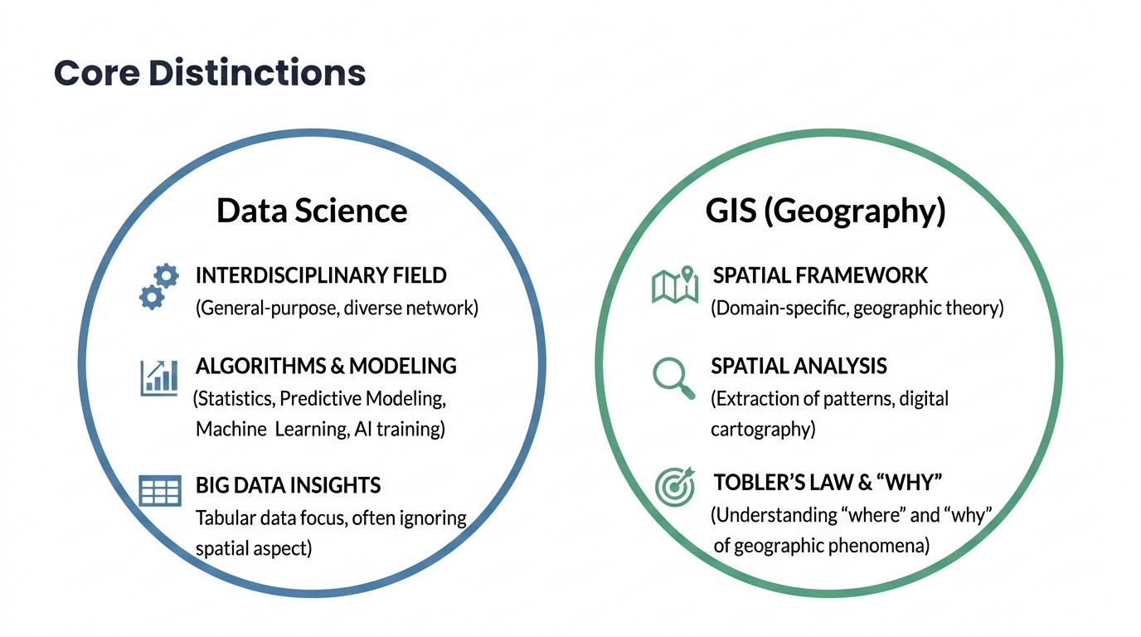

Slide 4
Core Distinctions
Perspective:
Data Science is general-purpose, focusing on patterns in diverse datasets. Is drawn from a very large and diverse network of disciplines.
GIS is domain-specific, rooted in spatial and geographic theory. Often has a more cohesive network of professionals
•
Methodology:
Data Science emphasizes data processing, predictive modeling, machine learning (and now AI training).
GIS emphasizes spatial analysis, extraction of data or spatial patterns, presents findings in digital cartographic representations.
Primary Goal:
Data Science seeks actionable insights from big data using tabular data. It often ignores that data is spatial.
Underpinned by Tobler's first law of geography - GIS seeks to understand the "where" and "why" behind geographic phenomena so that it can propose a “how”.

Slide 5
Summary Comparison
Feature | Data Science | GIS / Geography
Primary Tool | Python, R, SQL, PowerBI | ArcGIS Pro, AGOL/Portal, ArcPy, Notebooks
Analytical Focus | Predictive & Statistical, Insights with machine learning and AI | Spatial & Temporal, Dashboards, Web apps, Story Maps, Field Data Collection
Core Output | Insights / Models/Forecasts/ Datasets as results | Web Maps Services / Spatial Analysis and derivative datasets / Maintaining data as an Enterprise

Slide 6
What would a Union of the disciplines look like?
(what might the future bring?)

Slide 7
The evolution of "GeoSpatial Data Science" -
The Union that builds the future (today)
GeoSpatial Data Science is the evolution where the two fields merge (Union). It applies advanced data science techniques—such as deep learning and massive parallel computing—directly to spatial datasets…but also also gains from primary geospatial perspective, process, and community to uncover hidden patterns (geographic and temporal patterns).
This discipline moves well beyond traditional mapping or predictive questions like "Where is something at now or where might it be in a week or a month or a year?". It goes beyond showing data as a chart with a independent/dependent relationship.
The Union goes opens the heart of some very big problems - disease, untreated substance abuse and mental illness (homelessness), energy production and distribution, resource constraints, housing, generative AI predictive patterns, agentic decision support AND to it will also solve the mundane and intractable. The Union opens both worlds.

Slide 8
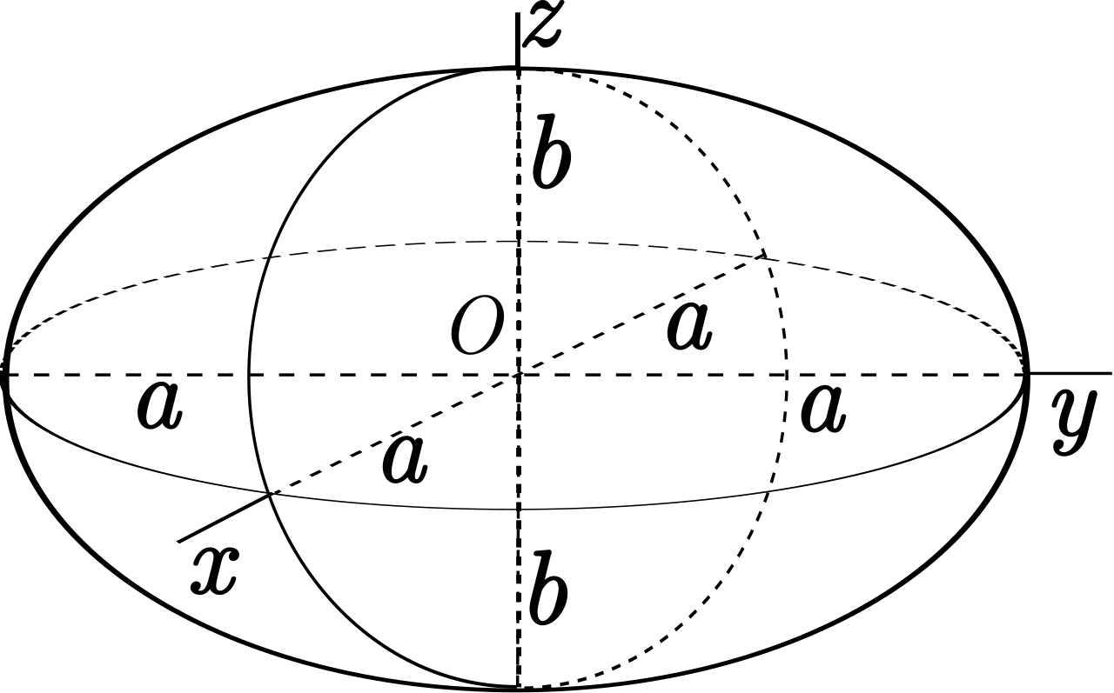
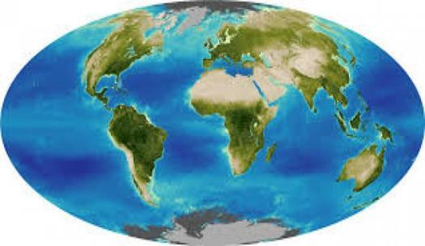

Slide 9
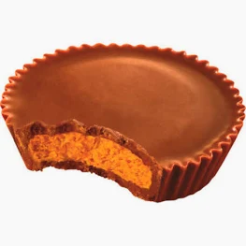
Where do we go?
"You got chocolate in my peanut butter! You got peanut butter on my chocolate!"

Slide 10
Proposal:
SDRGC creates a subgroups specifically for this kind of collaboration and learning between the disciplines:
Geospatial Data Science - Together Forward

Slide 11
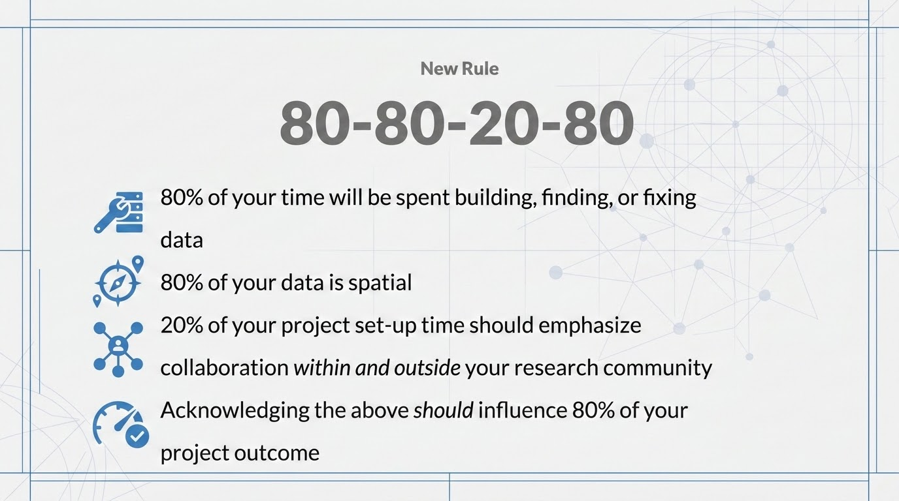

Slide 12
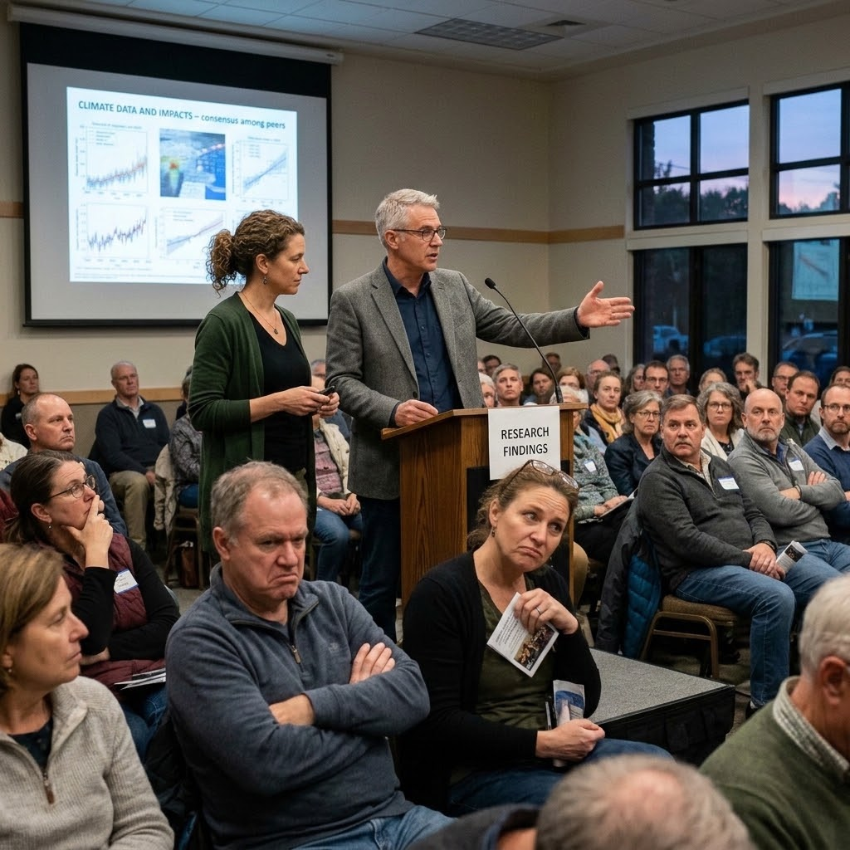
Where are we at with this?
Data Science
We are in it together!
GIS
I can prove anything by statistics… except the truth.
— George Canning 1827
The world

Slide 13
Thank you
Ross.Martin@sdcounty.ca.gov

